Slide 1
Powerpack Assembly Improvement Process
Interdisciplinary Capstone Project:
Brett Bone
Andrew Freeman
Austin McAnelly
Maryam Sabeghi
Company Advisors: Bruce Baxter, Jeff Wynott, & Fahad Khan
Faculty Advisors: Dr. Janet K. Allen & Dr. Zahed Siddique Supported by Dr. Randa Shehab & Dr. Farrokh Mistree

Slide 2
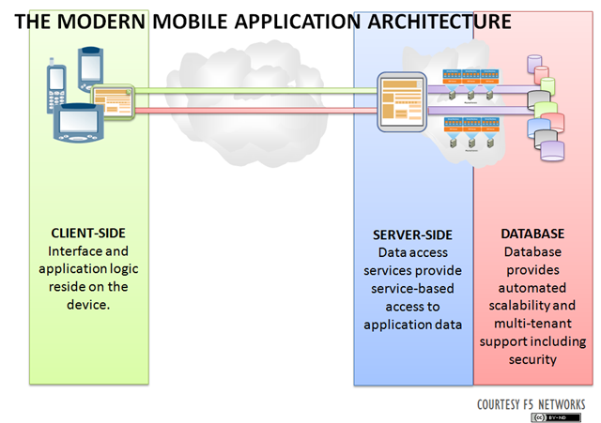

The “Cloud”

Slide 3

Hitachi Computer Products (America), Inc.
Founded in Tokyo, Japan
Oklahoma Manufacturing Division (OMD)
Norman
Tokyo
Notes:
We are working with Hitachi Comp. Products (America), Inc.
Hitachi, the parent company, was founded in 1910 in Tokyo, Japan.
It is a multinational conglomerate composed of multiple corporations in 11 different business sectors.

Slide 4
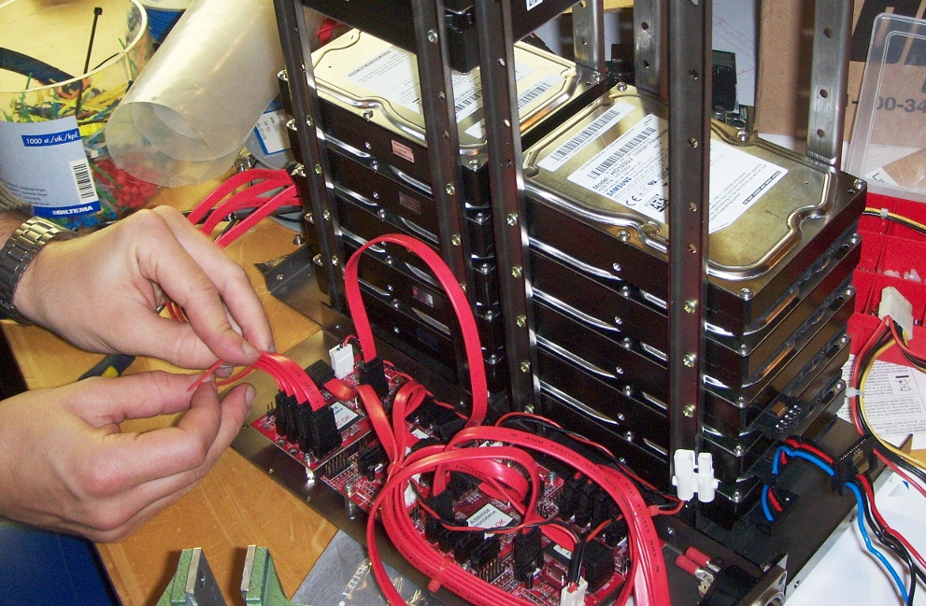
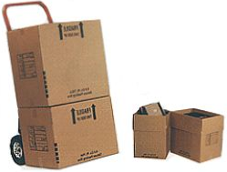
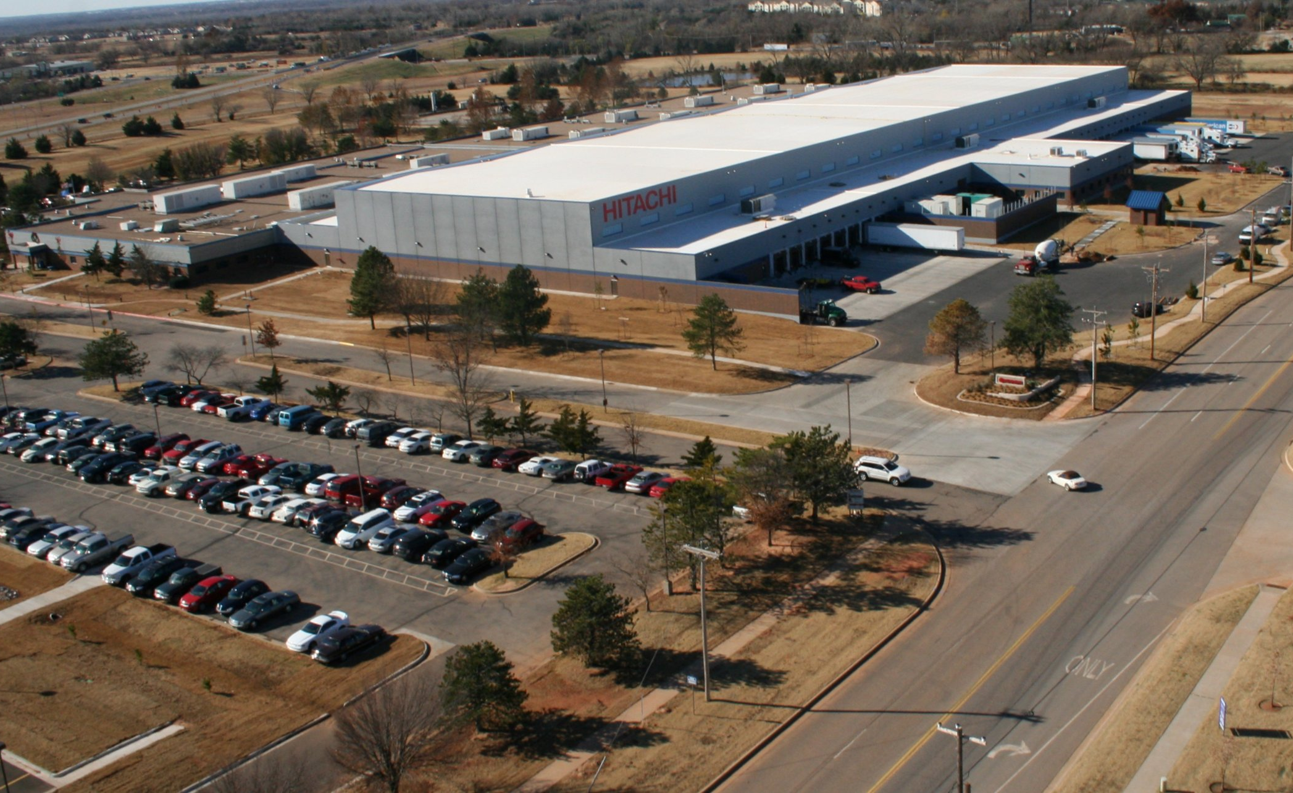
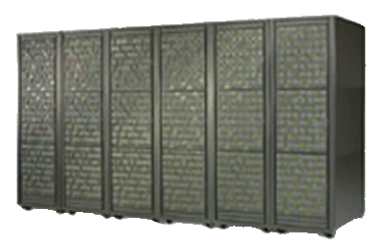
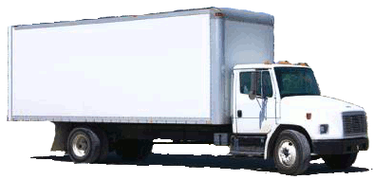
Hitachi Computer Products (America), Inc.
Founded in Tokyo, Japan
Oklahoma Manufacturing Division (OMD)
Assembly
Distribution
Norman Facility
Notes:
The Norman facility has two main functions: Assembly and Distribution.
They currently assemble RAID HDD Data Storage Units and Distribute these storage units among other Hitachi products throughout the U.S.

Slide 5
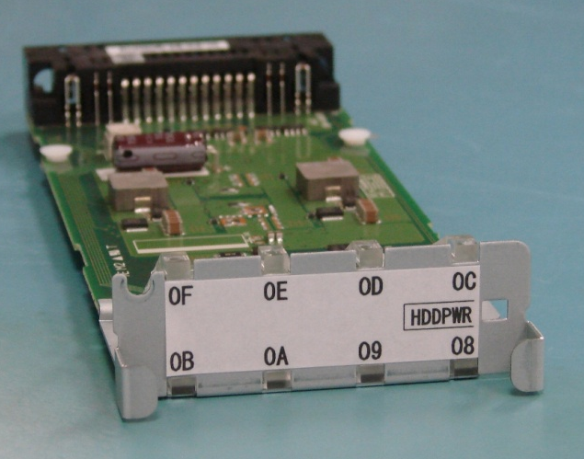
Problem Definition
Improve the current Powerpack assembly process and create a future roadmap for automation.
Approach
Manual Assembly
2. Immediate Improvement
1. Automation Plan
Notes:
Our team has been tasked with improving the current PowerPack assembly process and creating a future roadmap for automation.
Our approach includes first gaining an understanding of the current manual assembly process, looking for improvements that can be implemented quickly,
and finally creating a plan to automate the process in the future.

Slide 6
Problem Definition
Improve the current Powerpack assembly process and create a future roadmap for automation.
Objectives
Increase Hitachi’s competitive edge
Improved
Process
Increase Efficiency
Increase Quality
Reduce Manual Assembly
Notes:
Our main objectives all play into improving the process. First, we’d like to increase efficiency by causing reductions in the standard times for assembly.
Second, we’d like to increase quality by decreasing the number of defective assemblies.
Finally, we want to reduce manual assembly by replacing manual tasks with automated machinery.
These process improvements are important to Hitachi because it allows them to reduce their costs, which will in turn give them a edge over their competition.
Our main objectives when examining the process are to increase efficiency and quality and reduce manual assembly.
These objectives can be measured by a reduction in standard times, a reduction in defects, and replacing manual tasks with automated machinery.
Improving this process is important to Hitachi because it allows them to reduce their costs, which will in turn give them a edge over their competition.

Slide 7
Project Deliverables
Immediate Improvement
Design Concepts
Support Documentation
Requirements
240 PP/8hr Shift
Current Floor Space
Equipment Versatility
ESD Protection
Cost Justification
Automation Plan
General Design Concept
Comparison Analysis
Cost Analysis
Notes:
Design Concept/Support Doc: AWIs, Equipment Lists, BOM, Eng. Drawings
Comparison Analysis: CAD Drawing of Floor/Workstation Layout, ST of New Assembly, Model of Proposed Design
Cost Analysis: Equipment Estimates, ROI Explanation (Profitable)

Slide 8
Literature Review
Systems Approach
Project complexity requires a systematic approach
Pahl, G., & Beitz, W. (2007). Engineering Design: A Systematic Approach. (p. 126). Darmstadt, Germany: Springer.
Ergonomics
“Tools with straight handles are a good choice for tasks in which the force is exerted perpendicular to the straightened forearm and wrist.”
East, J. (2005). “Ergonomic Guidelines For Selecting Hand And Power Tools.” Occupational Hazards, 67(12), 39.
Automation
“Industrial Robotics Reduce Labor Costs and Increase Productivity”
Glaser, A. (2009). Industrial Robotics: How to Implement the Right System for your Plant. (p. 6). New York, NY: Industrial Press, Inc.

Slide 9
Methodology
Reevaluate
Define
Collect Data
Measure and Rank
Final Design
Generate
Determine Crux
Notes:
1) Clearly define 2)Collect Data 3) Determine Essential Elements of Process 4) Generate Solutions 5)Measaure and Rank Proposed Solutions 6)Detailed Design

Slide 10

Why Interdisciplinary?
http://wallpapers.free-review.net

Slide 11
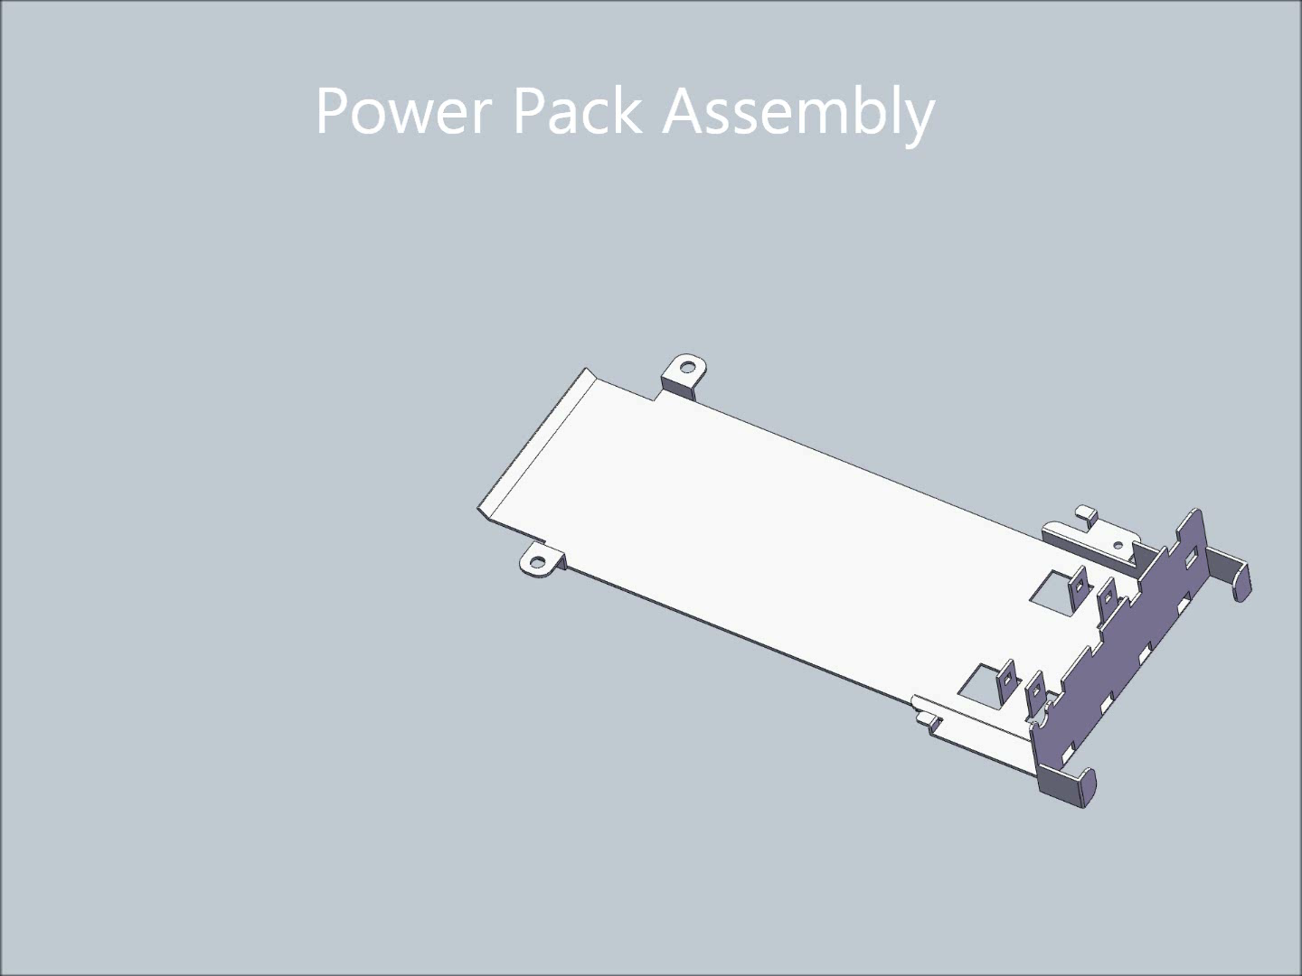
Assembly Video

Slide 12
Time Study Data
Percentage of Time Per Assembly Stage
Assembly Stage | Average | Std Dev
Grab bracket | 3% | 1.0
Insert lower light pipe | 4% | 1.1
Insert middle light pipe | 6% | 2.1
Insert top light pipe | 8% | 3.3
Place in jig | 4% | 1.5
Place bracket label | 12% | 1.5
Grab board | 8% | 2.2
Scan top, right side, bottom, table, click | 12% | 1.4
Insert board and push rivets | 15% | 3.4
Attach serial label | 11% | 3.1
Attach WEEE label | 9% | 2.5
Place in cart | 9% | 3.0

Slide 13
Objective I: Automation Plan
Create a high level roadmap for full automation plan
Take one component of the automation plan and present a valid design
Design for future additions to roadmap and reuse of selected equipment

Slide 14

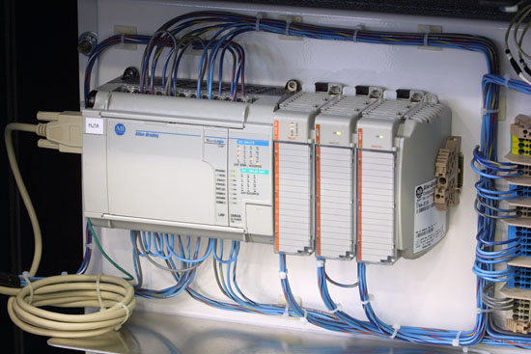

More Automation Plan
Allen-Bradley Programmable Logic Controller

Slide 15
Objective II: Immediate Improvements
Bracket
Light Pipes
Light Pipe Label
PCB Board and Rivets
Serial No. Label
WEEE Label
FINISHED ASSEMBLY
Light Pipe Label
The second objective is to develop a process or tool for immediate improvements which more efficiently place labels on the Powerpack assembly.
The first objective seeks to develop a long-term overall roadmap to automation for the entire Powerpack assembly process.

Slide 16
Design and Cost Criteria
House of Quality
Primary Performance Criteria
Lift Label
Move Label
Orient Label
Secure Label
Speed
Cost
Performance Requirements
label placement time: decrease by 50%
ROI ≤ 1 year
placement deviation ≤ 500 μm
operable in current workstation
prototype cost < $500

Slide 17
Concept Generation
Lift Label
Move Label
Orient Label
Place Label

Slide 18
Vacuum Label Placer

Slide 19
Prototype of Label Tool

Slide 20
Economic Analyses

Slide 21
Broader System Impacts
Ergonomics
Quality
Reduced Standard Time

Slide 22

Project Schedule
Jan.
February
March
April
May
Problem Identification
Data Collection
Analysis, Research, & Concept Generation
Create Automation Roadmap
Design Label Placement Device
Implementation and Documentation

Slide 23
Issues and Difficulties
Issues Faced
Managing expectations
Quantifying suction force required for lifting labels
Scheduling difficulties due to multidisciplinary
Late start
Estimating implementation costs and processing time for automation
Foreseeable Issues

Slide 24

Questions?

